Slide 1



Project
Paperie
2401-ABILASH
2415-ETHAN
2411-CLAYTON
2420-JOSELITO

Slide 2

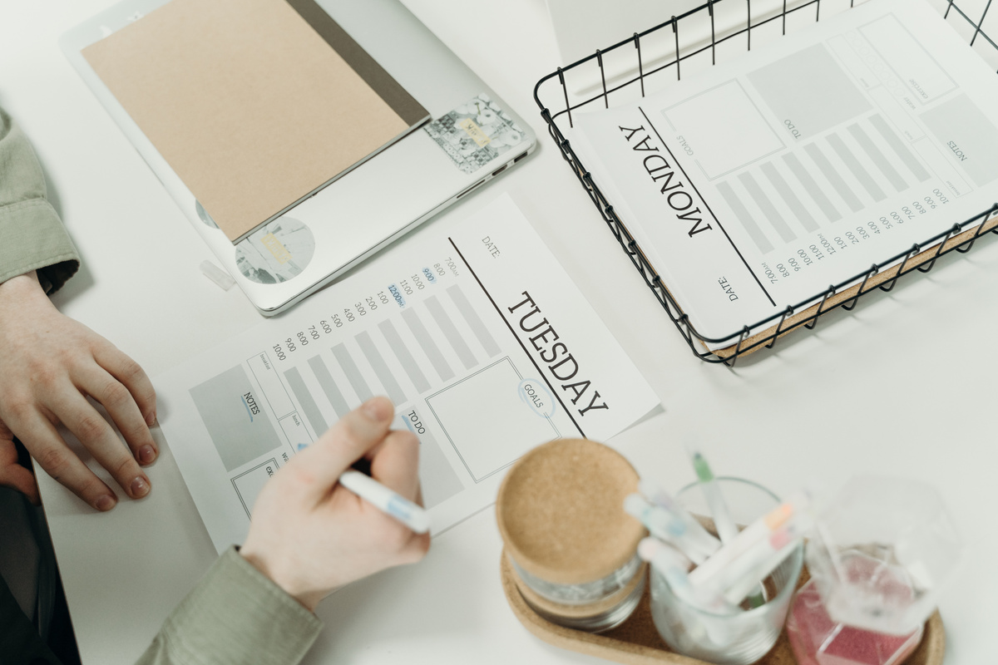
Introduction
A website for a business that makes wedding and birthday cards and sells additional items on the side like seals and decorations. The site includes information about the business like FAQs, portfolio of the owner, ability to place an order for a card , an e-commerce section of the site where the user can buy items in addition to the cards. The site includes an admin dashboard so that the owner can view statistics in the form of graph like the no of sales during a month and other important info like inventory remaining for different items.

Slide 3
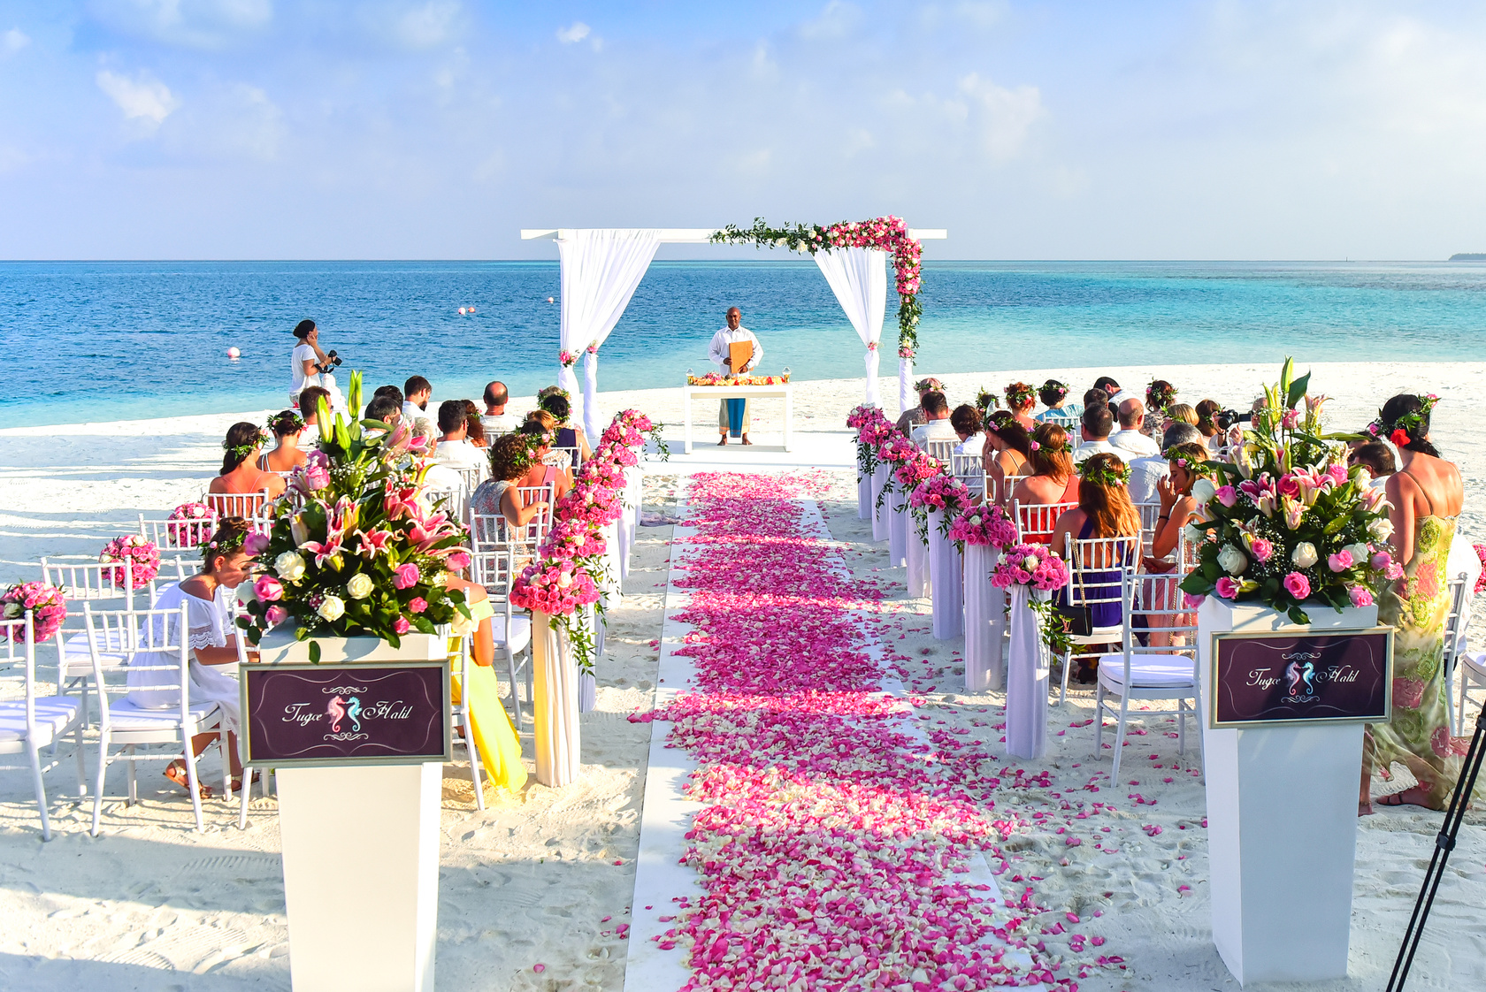
Features
1. Portfolio of client- shows recent work
Display completed projects with images, descriptions, and links.
Highlight services provided
Theme Highlights: Show different wedding themes/styles (e.g., rustic, beach, royal, modern).

Slide 4
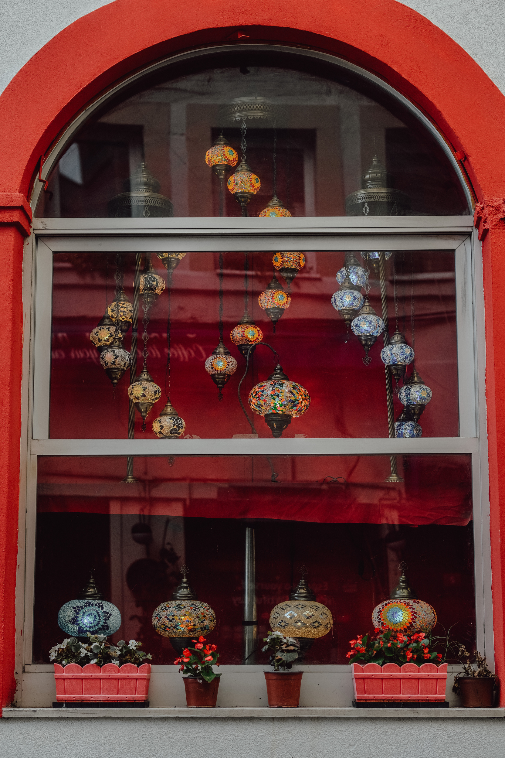
Features
2. E-Commerce Shop for Additional Items
Beyond custom cards, Paperie offers a dedicated shop section where users can browse and purchase additional decorative items such as:
✔ Seals & stamps for a classic finishing touch
✔ Ribbons, stickers, and embellishments to enhance invitations
✔ Envelope liners & specialty paper for a premium feel
✔ Gift tags & greeting cards for all occasions

Slide 5

Market Need
Growth of Online Shopping & Personalization
-More consumers are shifting to online purchases for wedding and party planning.
- People want the convenience of browsing, customizing, and ordering invitations online rather than visiting physical stores
Need in Birthday & Celebration Market
Birthday parties, baby showers, anniversaries, and housewarming ceremonies are now celebrated with theme-based invitations, creating demand for custom birthday cards and decorative accessories

Slide 6

Target Audience
Engaged Couples & Families Planning Weddings
Couples looking for personalized and elegant wedding invitations that match their wedding theme.
Parents and relatives who prefer traditional printed invitations for family and community distribution.
Event Planners & Corporate Clients
Professional event organizers handling weddings, birthdays, and corporate events.
Companies hosting annual functions, product launches, and corporate parties needing stylish invitations.

Slide 7
Timeline
February: Design Phase
Create wireframes & mockups
Choose color schemes & branding
Develop UI/UX prototypes
Get feedback & refine designs
March: Development Phase
Set up development environment
Code front-end & back-end
Integrate necessary features
Test functionality
April: Final Adjustments
Fix bugs & errors
Improve design & layout

Slide 8

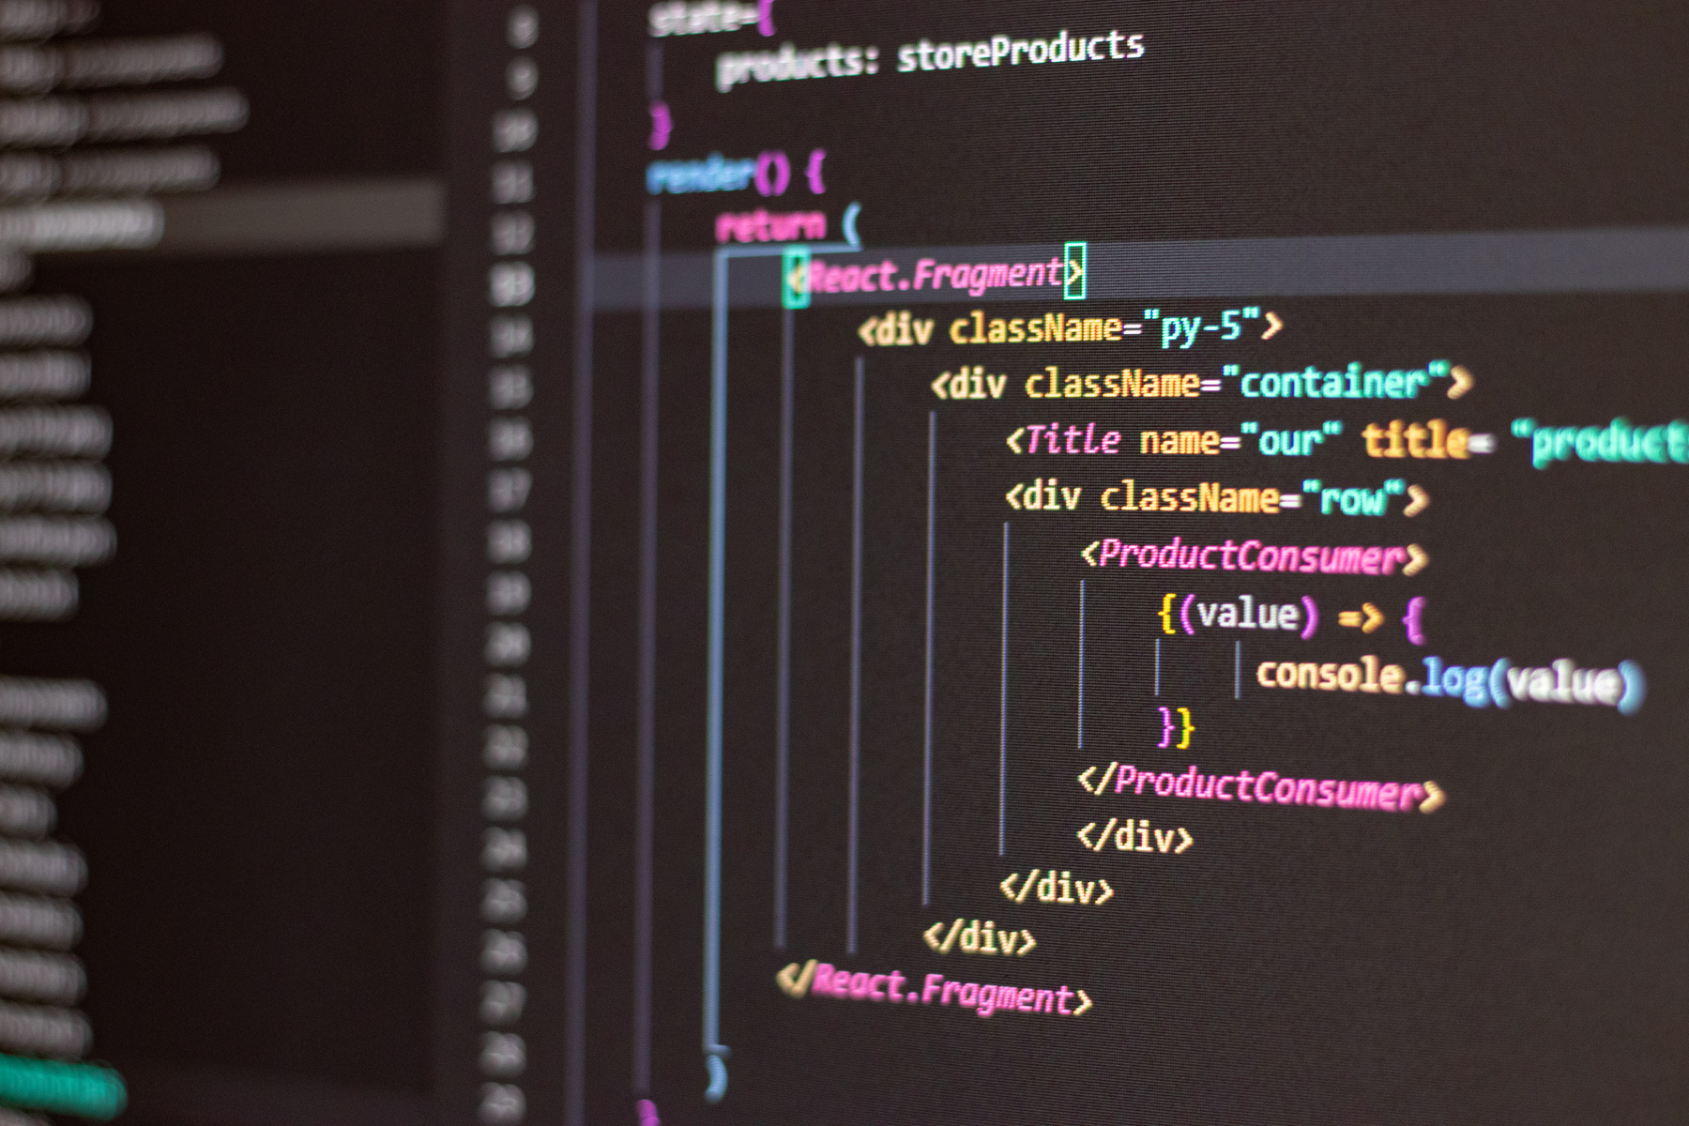
Technology
stack
MongoDB
Shadcn
React
Tailwind
www.reallygreatsite.com

Slide 9

Thank You

